Slide 1
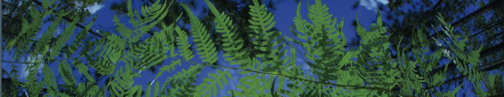

Phylogenetic Diversity
University of Florida

Slide 2
R based
“Demo/Rbased/CrashCourse/CrashCourse_2020.Rproj”
Navigate to Phylogenetic_Diversity.R

Slide 3
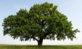
Phylogenetic Diversity:
How much of the Tree of Life is present in a geographic area?
Oaks
Vs.
Notes:
We can do this using something called phylogenetic diversity, instead of counting the number of species in an area, we can use their relationships to prioritize conservation decisions. How does this work?
PD measures how much of the tree of life is present in an area. Let’s say one area has 8 species, but they are all oaks. Now to oak specialists, or maybe event he squiirrels that eat the acorns, these oak species may seem different. But to most of us, and in relation to the rest of the Tree of Life, these species are all very similar. Another area also has 8 species, but they are much more diverse and cover more of the Tree of Life. This second area would have higher PD and might be a better option for conservation because more of the tree would be represented.

Slide 4
Phylogenetic Diversity:
How much of the Tree of Life is present in a geographic area?
Oaks
Vs.
Notes:
So for any area, such as a small region of the Panhandle, we can ask which species are there, and how much of the tree do they represent?

Slide 5
What to Protect?
Notes:
When we examine biiodiversity hotspots, such as those in California, the Appalachians, and Florida, how do we determine what species or areas to protect? Often decisions are based on the number of species present, or on a special so-called indicator species. But what if we used the power of the tree of life to aid conservation decisions?

Slide 6
How much of the Tree of Life is present in an area?
Allen et al.. 2019. iScience11: 57–70
Allen et al. 2019. Nature Plants 5:11-13.

Slide 7
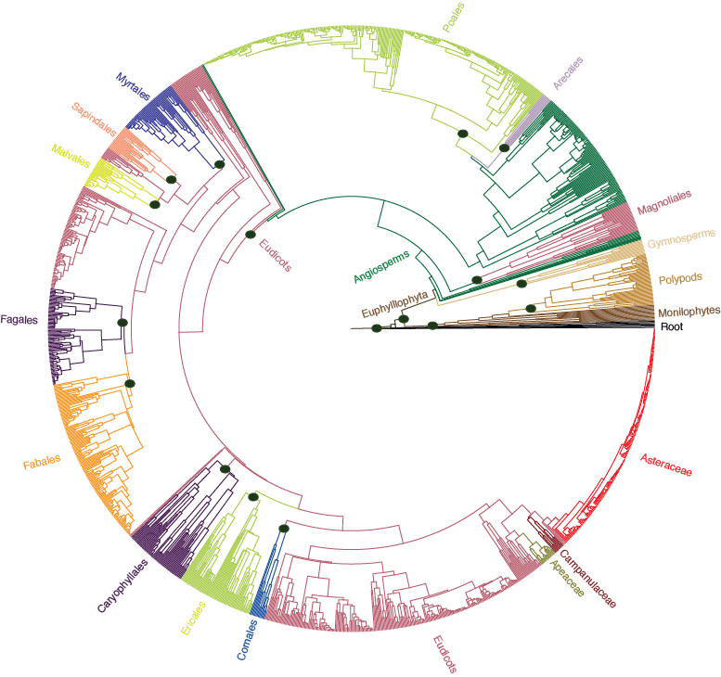
Phylogenetic Diversity
Florida Plant Phylogeny
Notes:
To measure PD, we need a tree – this is a phylogeny of Florida plants – and

Slide 8
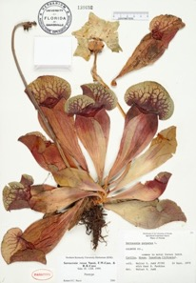
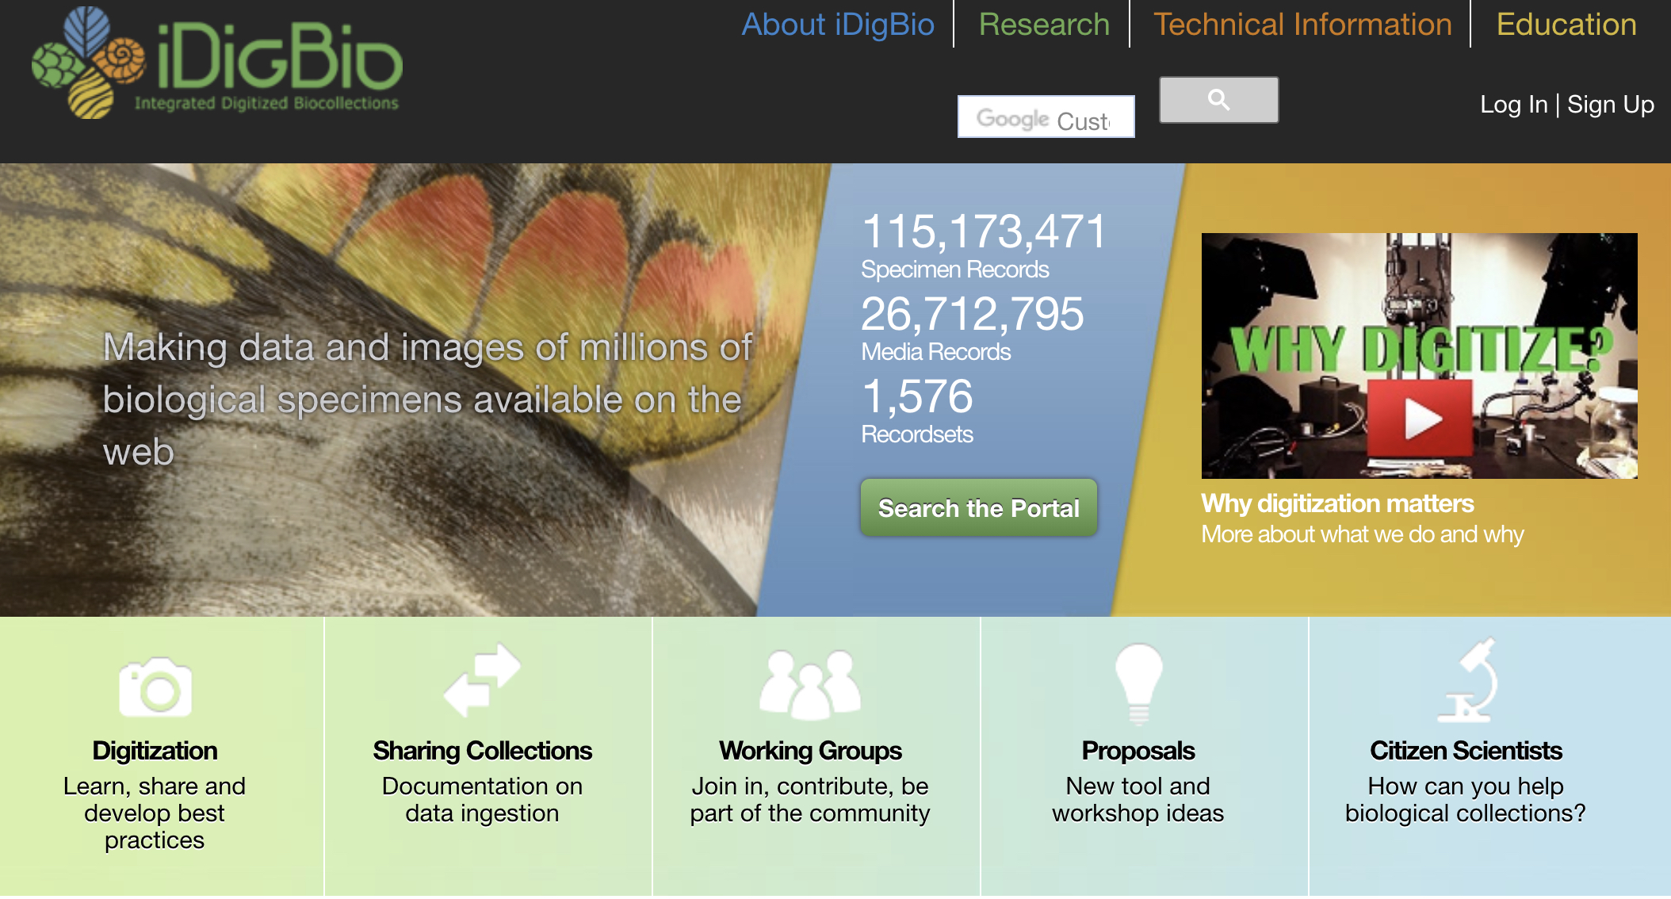
Locations: iDigBio
www.idigbio.org
Notes:
And locality information. We get these occurrences from herbarium specimens, such as the half million pressed plants housed in the Florida Museum’s herbarium. Databasing of musuem specimens from around the world has produced an immense resource of location information stored in iDigBio, the national center for digitized biodiversity collections, housed here at UF.

Slide 9
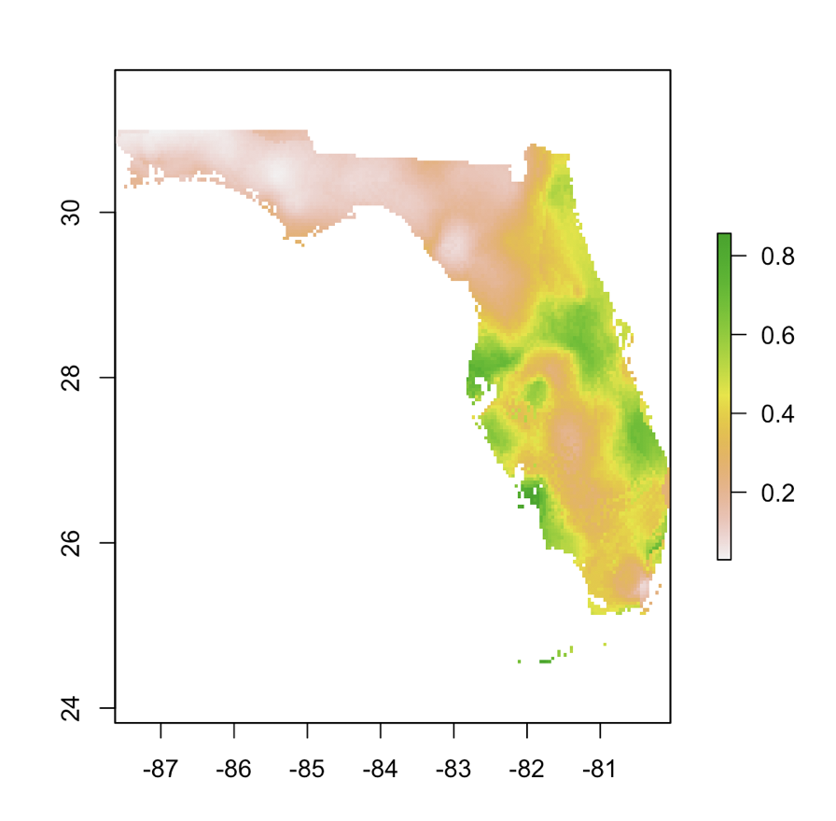
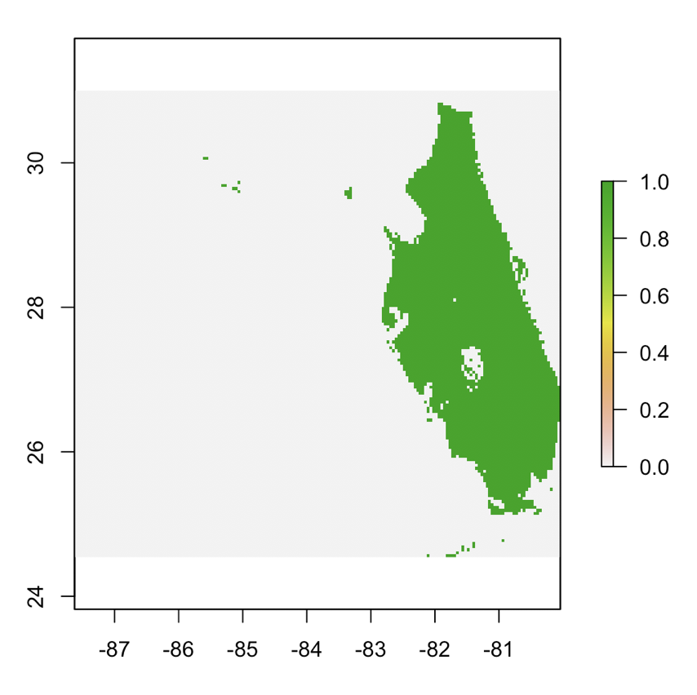
We can use our niche modelling data to plot species distributions!
Average Suitability
Presence/Absence
Reclassify

Slide 10
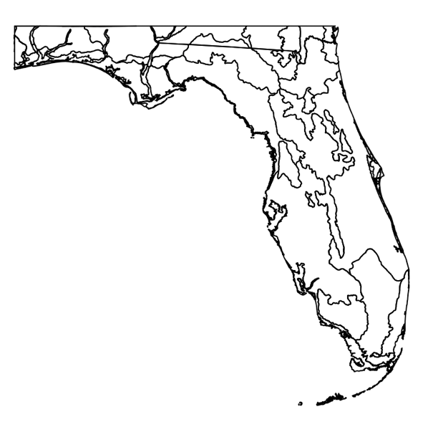
We can use our niche modelling data to plot species distributions and compile across species!
Stack rasters
For different
species
Create a
data frame
Convert
to points
Ecotype-based Communities
Match points to different ecotypes

Slide 11
Phylogenetic Diversity (PD) of Plants in Florida
Species list at each pixel, plot on tree
8,045 pixels/communities
16 km² per pixel

Slide 12
Phylogenetic Diversity: Florida Plants
Notes:
So with a tree and location information, we can compute PD and plot values across a region, such as Florida. There are regions of low PD… and regions of high PD…

Slide 13
Phylogenetic Diversity: China
Lu et al. 2018 Nature

Slide 14
Protected Areas vs. High PD in China
Lu et al. 2018 Nature
Notes:
This same approach can be applied to much larger geographic regions. Here we, with some Chinese collaborators, applied the same methods to China. And we can see that the regions with the highest PD, in pink and blue – subtropical forests, in S China, are not the regions that are under greatest conservation – these large expanses of green in western China that include grasslands.
Studies using the tree of life have great potential for conservation.

Slide 15
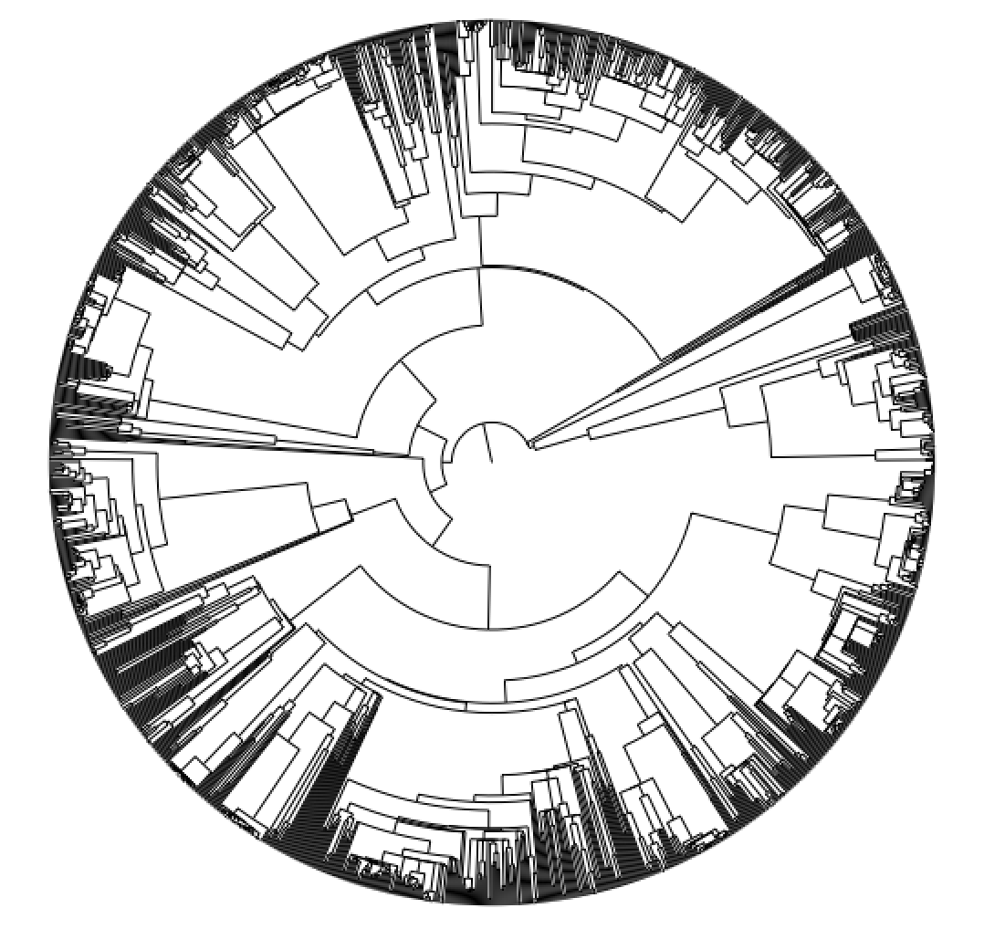
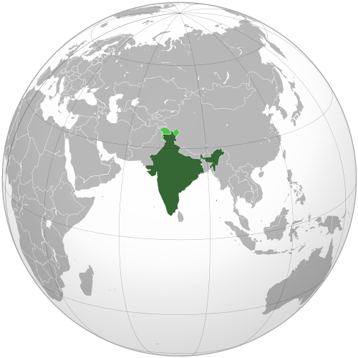

How do I do this kind of work?
Phylogeny
Occurrences
GBIF; iDigBio

Slide 16
Community Phylogenetic Structure Metrics
PD → Faith’s phylogenetic diversity
“total branch length spanned by the tree including all species in a local community” (Kembel, 2010)
TREE
COMMUNITY MATRIX
A
 | Sp1 | Sp2 | Sp3 | Sp4 | Sp5 | Sp6 | …
Comm1
Comm2
Comm3
Comm4
…
B
C
D
E
F

Slide 17
Phylogenetic Diversity Calculations
10
A
8
COMMUNITY 1
E, F
B
4
1
C
2
PD = 1 + 1
4
D
2
1
6
E
1
F

Slide 18
Phylogenetic Diversity Calculations
10
A
8
COMMUNITY 1
E, F
COMMUNITY 2
A, C, E
B
4
1
C
2
PD = 2
PD = 10 + 4 + 1 + 2 + 6 + 1 + 2
4
D
2
1
E
6
1
F

Slide 19
Phylogenetic Diversity Calculations
10
A
8
COMMUNITY 1
E, F
COMMUNITY 2
A, C, E
B
4
1
C
2
PD = 2
PD = 26
4
D
2
1
What do these numbers mean?
6
E
1
F

Slide 20
Phylogenetic Diversity Calculations
10
A
8
COMMUNITY 1
E, F
COMMUNITY 2
A, C, E
B
4
1
C
2
PD = 2
PD = 26
4
D
2
1
What do these numbers mean?
NEED TO COMPARE TO NULL MODELS
6
E
1
F

Slide 21
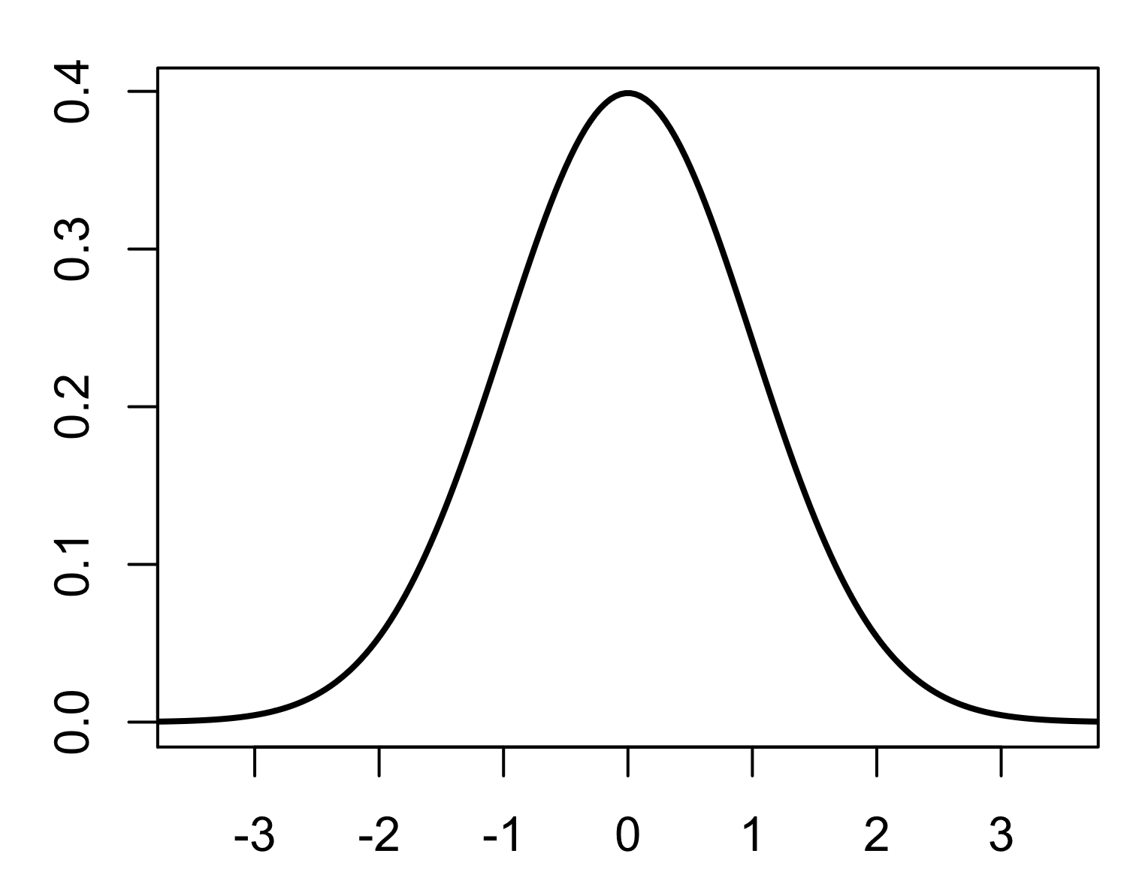
Randomize data by reshuffling of tree tips:
Produce z-values = Standardized Effect Size (SES)
Ses.pd, ses.mpd and ses.mntd
-z, p <0.05 → underdispersion
+z, p >0.95 →
overdispersion
UNDERDISPERSED (CLUSTERED)
RANDOM
OVERDISPERSED
A
A
A
B
B
B
C
C
C
D
D
D
E
E
E
F
F
F

Slide 22
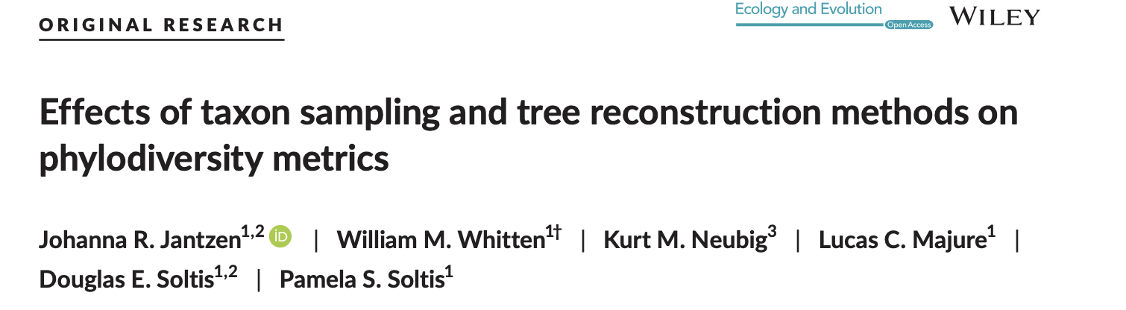
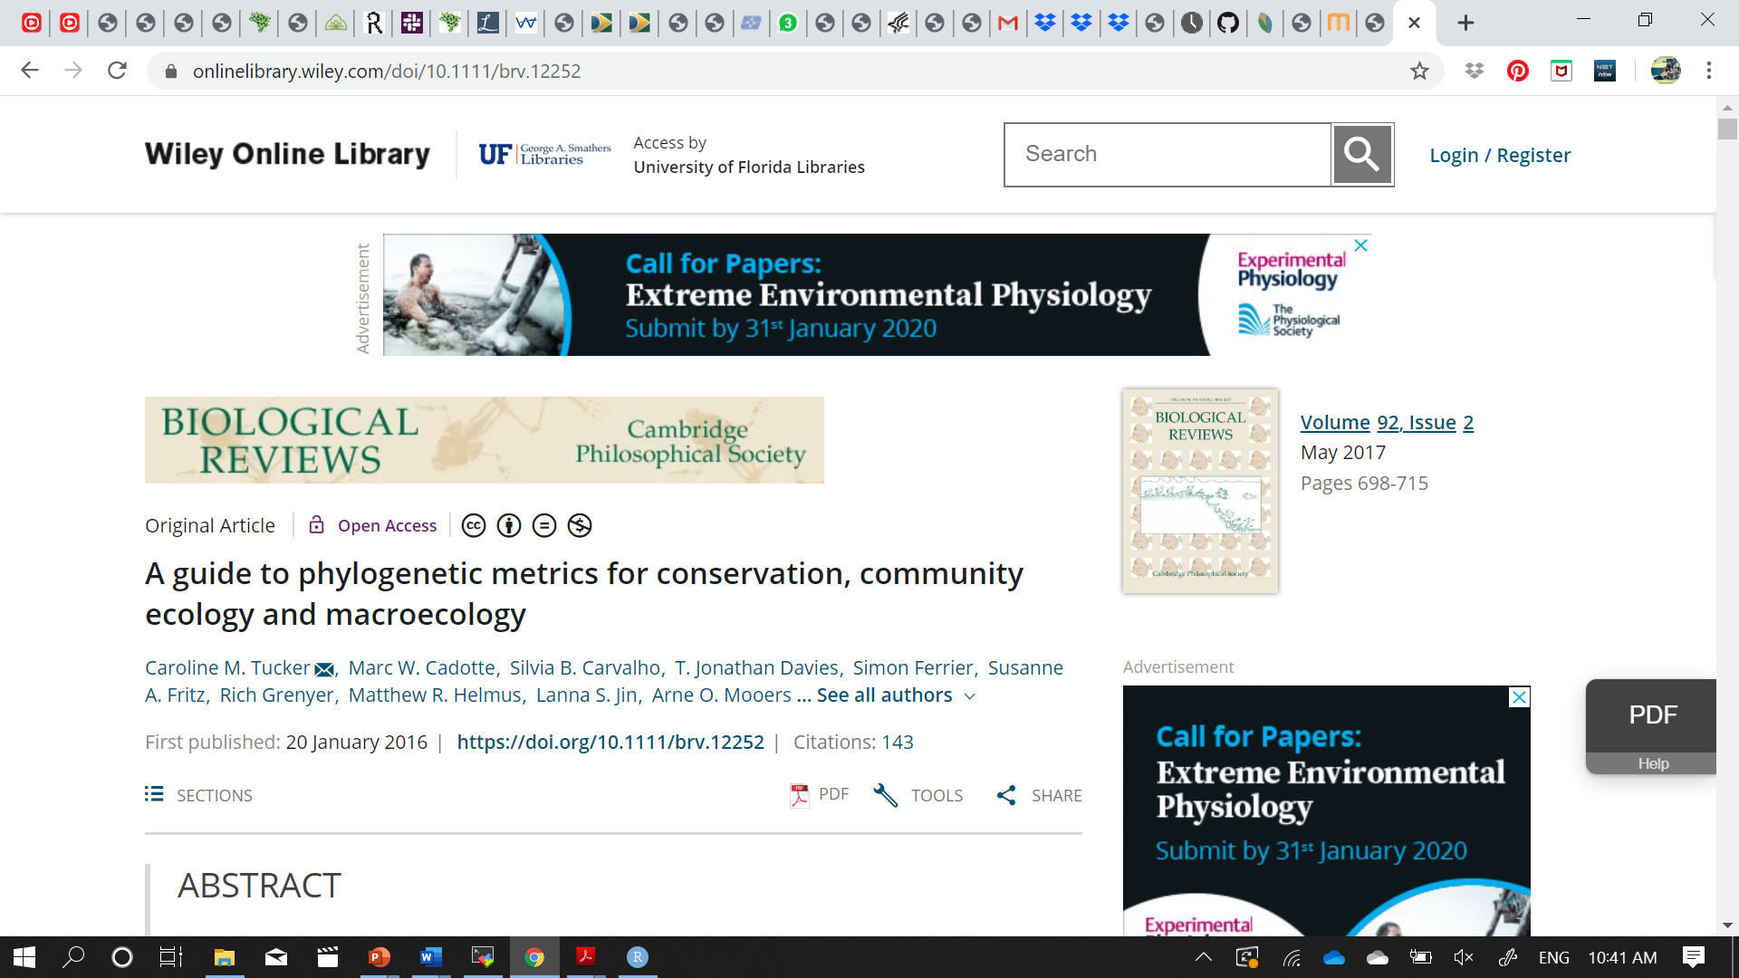
More on PD metrics

Slide 23

Other Analyses
“Biodiverse is a tool for the spatial analysis of diversity using indices based on taxonomic, phylogenetic, trait and matrix-based (e.g. genetic distance) relationships, as well as related environmental and temporal variations.”
Laffan, S.W., Lubarsky, E. & Rosauer, D.F. (2010) Biodiverse, a tool for the spatial analysis of biological and related diversity. Ecography. Vol 33, 643-647 (Version 1.0).
Notes:
Very helpful for spatial

Slide 24

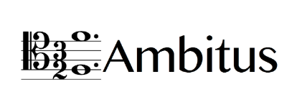
Other Analyses
Ryan Folk
New Bayesian pipeline – wrapper for BayesTraits (ambitus)
Aim is E-space distributions on ancestral taxa
New code to project on geographic space – binary and binned posterior probabilities

Slide 25
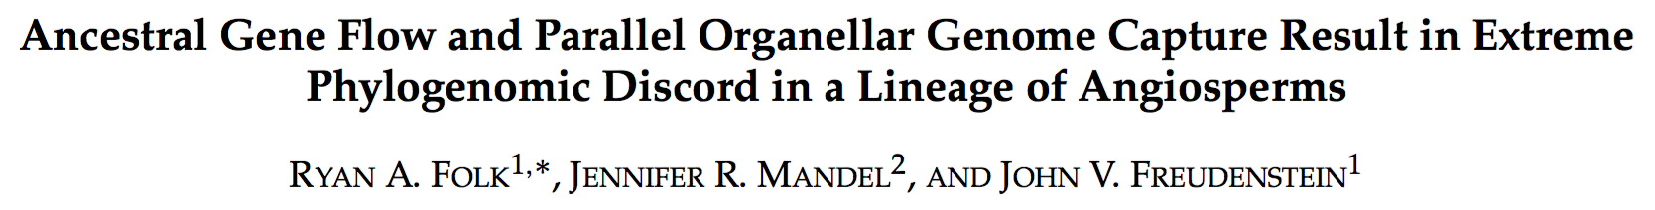
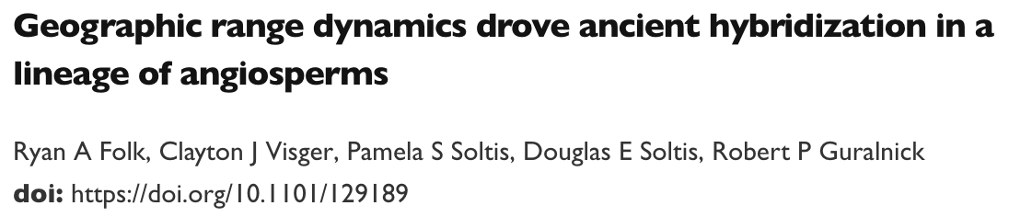

Slide 26
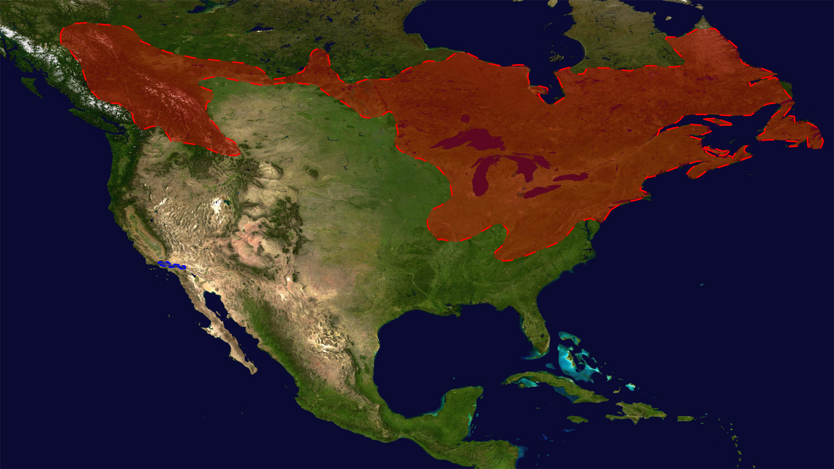
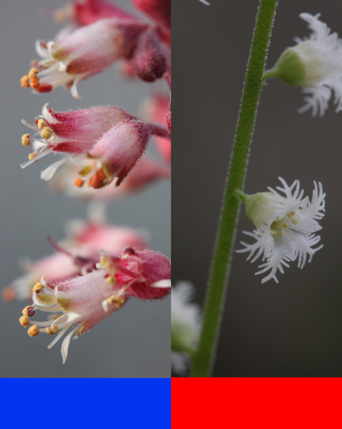
Solving a Hybridization Puzzle
cpDNA capture
Heuchera
Mitella
Ryan Folk

Slide 27
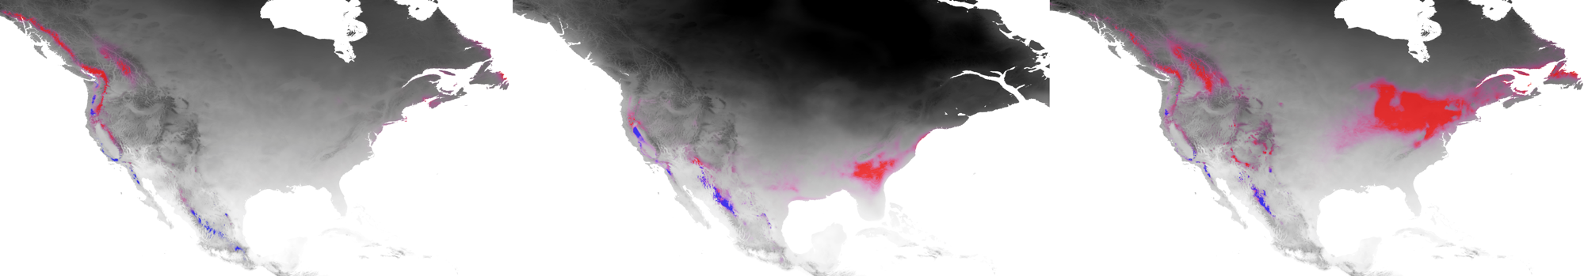

Ancestral Niche Reconstruction
Heuchera
Mitella
Notes:
Then used paleoclimatic projections –worldclim—to assess possible niche overlap through time

Slide 28
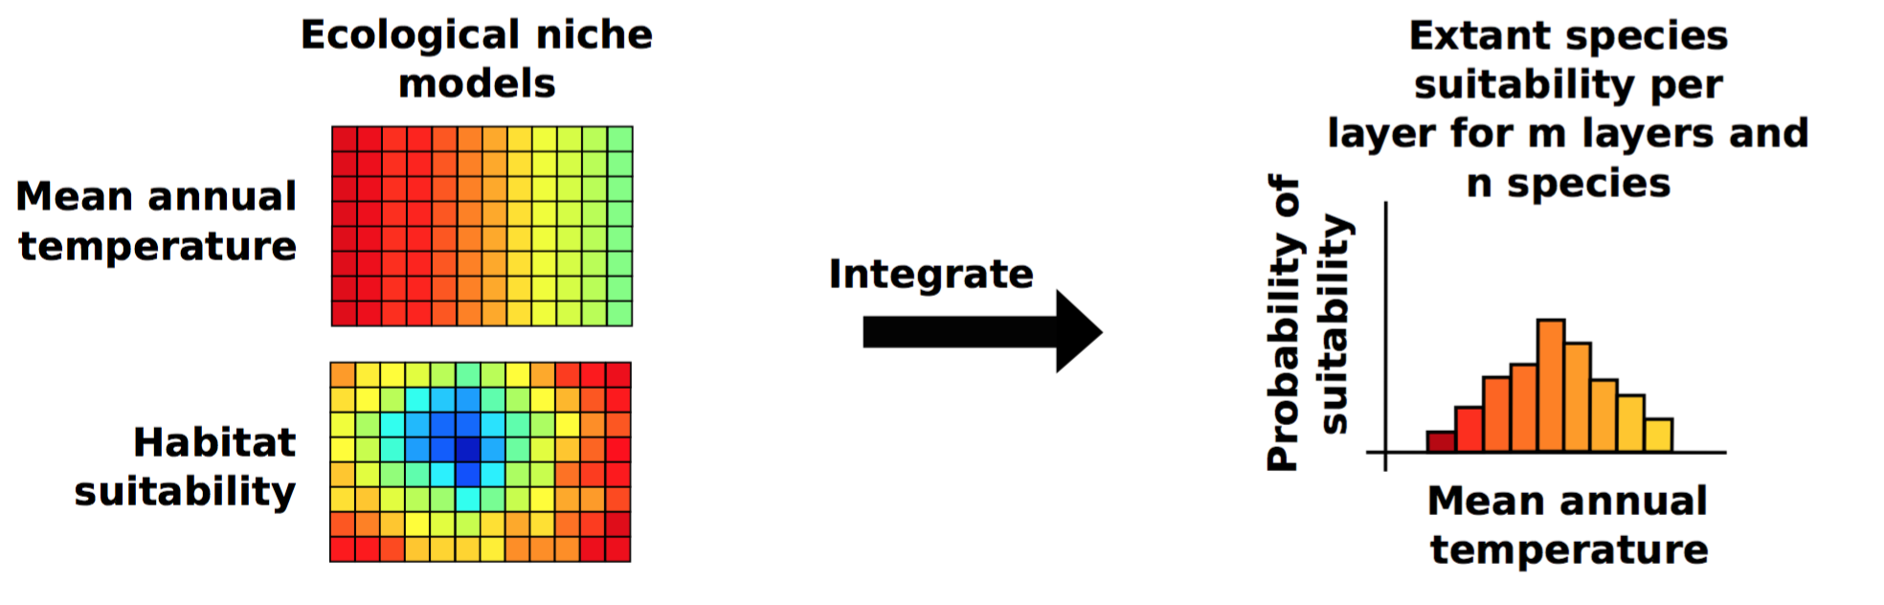
Other Analyses

Slide 29
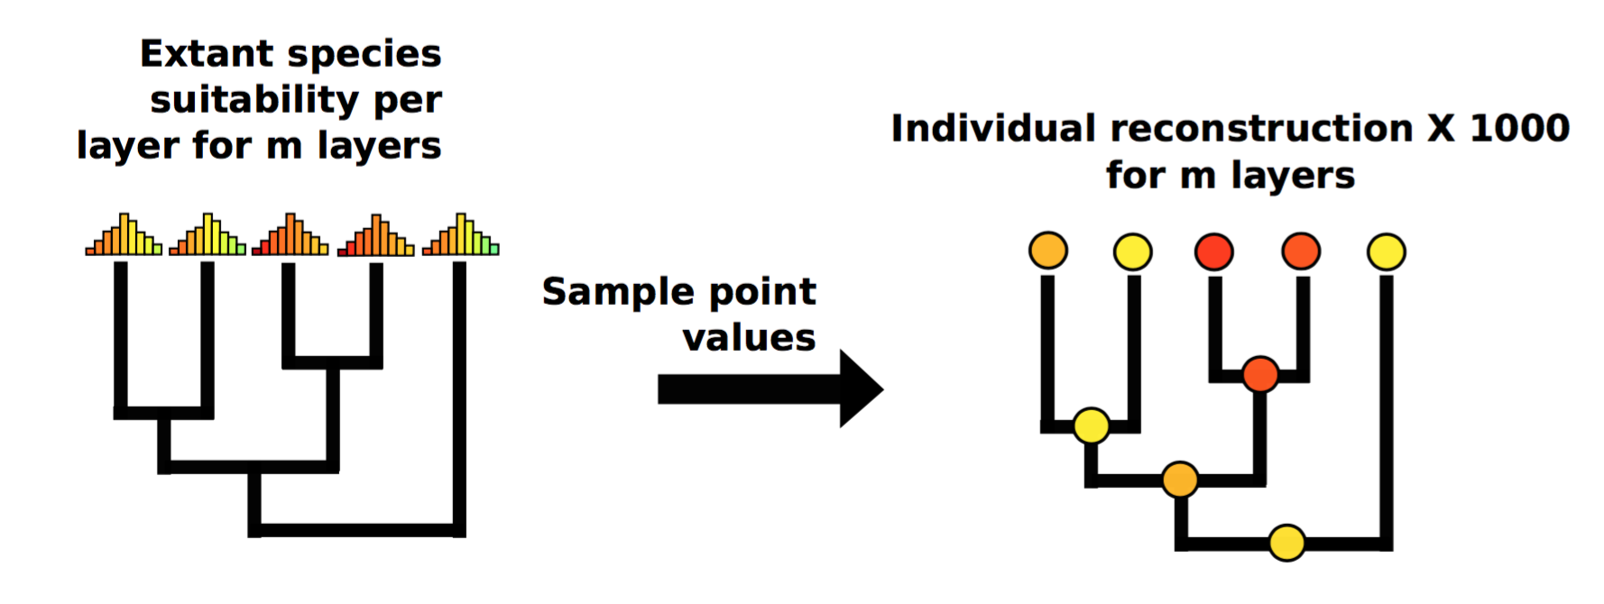
Other Analyses

Slide 30
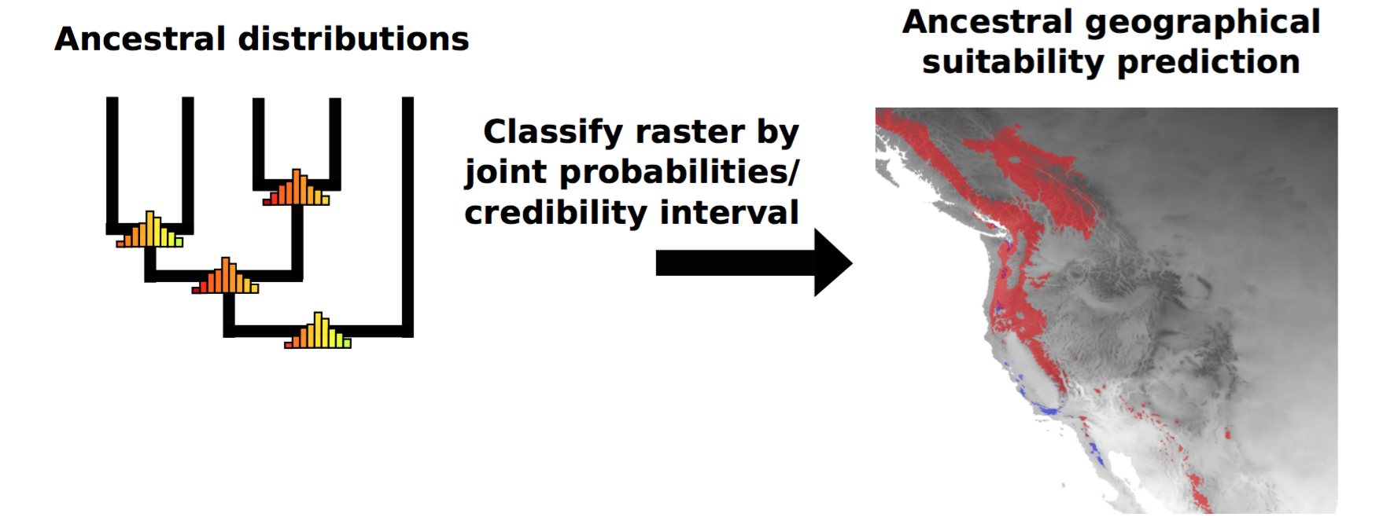
Other Analyses

